Slide 1
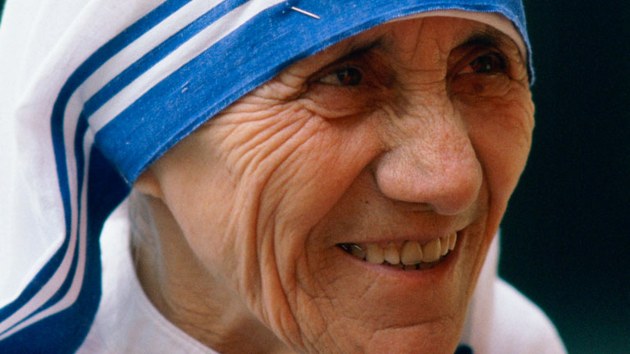
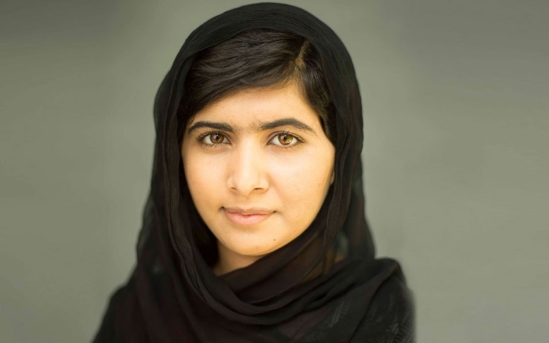
Malala Yousafzai and Mother Teresa
By ‘The World of Philosophers’

Slide 2
Malala Yousafzai

Slide 3
life
Inspiring, one word you can use to describe Malala. Malala Yousafzai was born on the 12th July 1997 in Mingora, Pakistan. She was the eldest child in her family, and had two younger brothers. Her family ran a chain of schools, which was founded by her father, Ziauddin Yousafzai, who was an education activist. He taught Malala English, Pashto and Urdu and as Malala attended one her father’s schools, her father had found out and sensed something special in Malala. And he encouraged her to express herself freely. Her hometown was rather exciting and busy, as it was a tourist attraction for summer festivals. But this had all changed when the Taliban came and tried to take control.

Slide 4
life
At a young age, Malala Yousafzai felt girls should have a right towards education like boys and she defied the Taliban. In 2012, she was shot in the heat by a Taliban Gunman, and fortunately she is alive. In 2011, the BBC used Malala Yousafzai as a reporter in Afghanistan for the war going on. Malala’s face was not shown on TV, but instead she done voice overs on the report and she told the BBC that she would not disclose her real name to the public but instead use the alias name Gul Makai. When she was 14, she found out that the Taliban had issued a death threat for her and her family thought the Taliban would not hurt a child, but behind closed doors something bad happened. When Malala was travelling home by bus from school, there was a Taliban gunman on board. This gunman demanded to know where Malala was and her friends gave away where she is – they began making eye contact with her. The gunman shot an innocent girl on the head on the 9th October 2012.

Slide 5
Personal philosophy
Through Malala Yousafzai’s activism, to spread awareness for the need of girls to have access to education, she has taught, as one of her key teachings that gender inequality is not acceptable, and that women/girls should deserve a right to education. As one of, quotes stated that ‘Do remember one thing. Malala day is not my day. Today is the day of every women, every boy and every girl who raised their voices for their rights.’ From this we can work out that she not only teaches to raise our voices for our right for our education, but to raise our voices for our rights. Malala was influenced by her father, as he was the one who had saw the spark in her, who saw that she was a bright child. And when he knew this he had encouraged her to follow her dreams, and what she believed, no matter what got in her way. To always follow her beliefs. Without her father she would not have spoken out.

Slide 6
achievements
Malala Yousafzai is a very inspiring person to look at when growing up. She has won a numerous amount of awards; from the Nobel Peace Prize in 2014 to the United Nations Prize in the Field of Human Rights in 2013. Malala has done many good things in life – from changing girls lives from across the world by giving themselves a right to education to showing people that speaking out and taking action will always get you somewhere and will do good for you. She has won the Nobel Peace Prize in 2014, the National Malala Peace Prize in 2011, the United Nations Prize in the Field of Human Rights in 2013, the Mother Teresa Awards in 2012, the Ambassador of Conscience Award in 2013 and many more…

Slide 7
achievements
Malala’s works have influenced many people – it has influenced the world. We can learn a lot from her beginning like standing up for ourselves and doing what is right. A girl who has been influenced by Malala is Anoyara Khatun from West Bengal in India. Anoyara Khatun learnt a variety of skills from Malala, and she made her voice heard after having many experiences with child exploitation. Like Malala she felt it was necessary to do something about this matter and she joined the Save the Children Multi-Activity Centre in her area to stop child exploitation. She has helped reunite 180 trafficked children with their families, prevented 35 child marriages, rescued 85 children from child labour and helped 200 children get registered into school.

Slide 8
Personal reflections
Malala Yousafzai is Philosopher who really fought for what she believed in. And we can learn several things from her. One factor, is to give up on your beliefs and dreams. This is because we know that Malala had felt strongly about the restriction for her education and other girls in her village. But she did not give up, she fought for her rights, she wanted the right education for girls. It was certainly not acceptable for. Her actions have influenced ours. And we have learnt that you should not give on your beliefs. Also we can learn that you shouldn’t let anything get in our way. This shown, when Malala gets shot in the head, but she does not give up. One of her quotes states this ‘You can only shoot a body, they cannot shoot my dreams’. This is what is meant by not giving up. When she experienced being shot she says, that they can do that but they can’t shoot by dreams away.

Slide 9
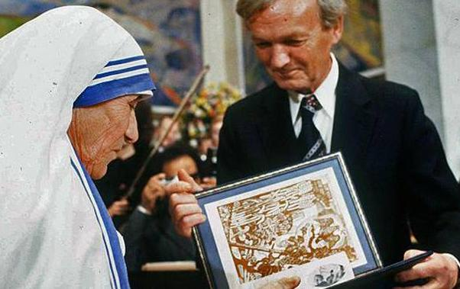
Mother teresa

Slide 10
life
Mother Teresa was born on the 26th of August 1910. She was baptised the next day in a local church. She was born to an entrepreneur and to a church volunteer. Her mother was extremely religious and she frequently told Mother Teresa stories about their religion and how you should give to others and follow God. This was key factor in her life as she devoted her life to her religion and tov the sick and poor. In 1919, when Mother Teresa was only 8 years old, her father suddenly fell ill and died. No one knows why he had died but the outcome of this was that Mother Teresa became extremely bonded to her mother.Her mother taught to never eat a single mouthful unless you are sharing it with others. This quote stayed with Mother Teresa and made her who she was.

Slide 11
life
A while later left to India to teach. She spent the next 17 years of her life in India and it was there that she decided to devote her life to the poor. Afterward she was sent to Calcutta, where she was assigned to teach at Saint Mary's High School for Girls, a school run by the Loreto Sisters and dedicated to teaching girls from the city's poorest Bengali families. From that day forth she tried her best to help others. After several years of deteriorating health in which she suffered from heart, lung and kidney problems, Mother Teresa died on September 5, 1997 at the age of 87. Her legacy to help others still lives on in many.

Slide 12
Personal philosophy and personal reflections
We can learn a lot form Mother Teresa. For example treat people the way you want to be treated or even believe and God will do the rest. Also we can learn to never give up. There is a clear example of this when her father died and she became alone and scared ,but, instead of giving up she got back up. I was traveling to Darjeeling by train, when I heard the voice of God, he told me do stop what I am doing and to help people. It was that day which inspired Mother Teresa to help people and be the person she was. Her faith in humanity was far greater than anyone alive. She was a saviour. I was traveling to Darjeeling by train, when I heard the voice of God, he told me do stop what I am doing and to help people. It was that day which inspired Mother Teresa to help people and be the person she was. Her faith in humanity was far greater than anyone alive. She was a saviour.

Slide 13
achievements
Prominent religious figure, saint and nun Mother Teresa, provided physical and emotional support to hundreds of homeless and sick individuals; she received numerous awards and honours for her efforts, including the gold medal of the Soviet Union's Peace Committee. She also awarded the Nobel Peace prize in 1979 for contributing to our society by putting others before her. It is evident when she struggles to help diminish poverty.

Slide 14
Similarities and differences between mother Teresa and Malala yousafzai
There are many similarities between Malala Yousafzai and Mother Teresa. For example they both fought for equality and education between people. Also the fact that they both are truly remarkable. The differences between them are that Malala Yousef did what she did naturally whereas Mother Teresa was told to do so.

